Slide 1
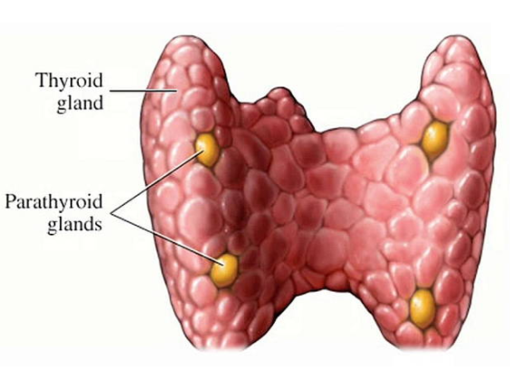
The Thyroid
Hormones, Regulation and Disease
Ch 2 Human Perspectives

Slide 2

Date: | Human Biology Year 12 ATAR
Do Now Do the Formative Assessment provided about Growth Hormone – note that this is closed book, under test condition. Lesson Agenda 1: Do Now 2: The Thyroid Gland location and structure Hormone production and regulation Effects on target tissues Disorders 3: Do the review worksheet provided 4: Lesson summary and wind-up Suggested Study Finish and mark any questions you did not get to complete from the review worksheet. Practice drawing an annotated flow chart for Thyroxine regulation. NEXT LESSON Formative Quiz on today’s work (not for marks) The Parathyroids and calcium regulation. | Learning Aims Describe the structure and location of the thyroid gland List hormones produced by the thyroid. Explain in detail how thyroxine is regulated and its effects on the body. Discuss disorders related to over and undersecretion of thyroxine
 | Key Vocabulary Negative feedback Homeostasis Set Point Regulation Target Tissues

Slide 3
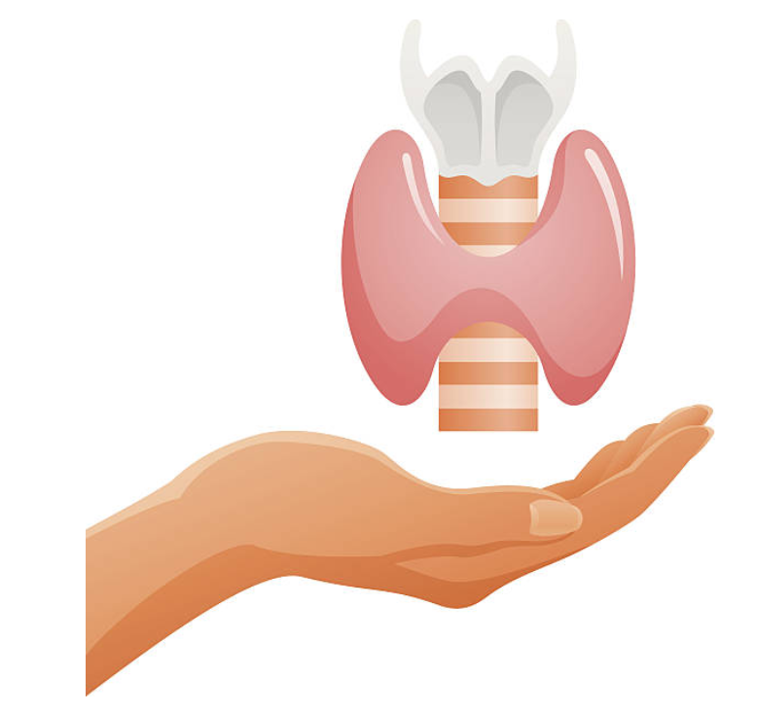
The Thyroid: Hormones and Regulation

Slide 4
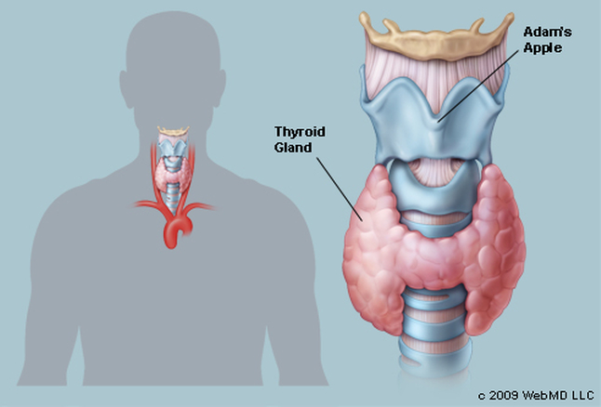
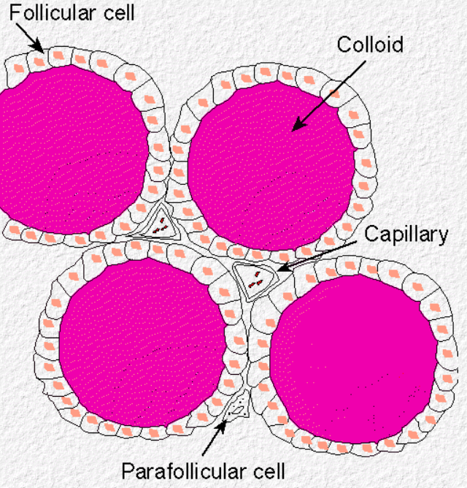
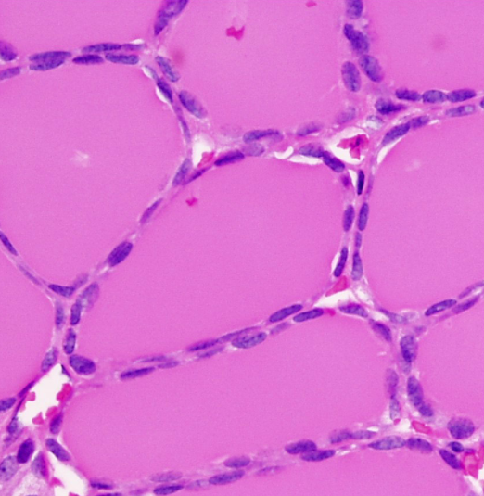
Thyroid location and structure
Butterfly-shaped organ
Located at base of neck
Produces
Thyroxine (T4) – metabolic regulation
Triiodothyronine (T3) – metabolic regulation
Thyrocalcitonin – calcium homeostasis
Learning Aim: Describe the structure and location of the thyroid gland
Learning Aim: List hormones produced by the thyroid.

Slide 5
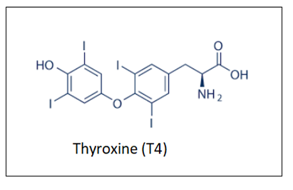
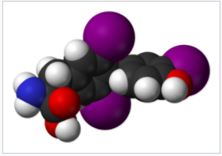
Thyroxine (T4)
Made by the Thyroid from Iodine consumed as part of the diet
Regulates metabolic rate through wide range of effects:
Increases basal metabolic rate (BMR) and temperature by
increasing catabolism of protein and carbohydrates
Increases heart rate, cardiac output, respiratory rate
Raises blood sugar
Converts glycogen to glucose
Increases absorption of sugar from intestine into
blood
Assists with brain development in utero
Learning Aim: Explain in detail how thyroxine is regulated and its effects on the body.

Slide 6
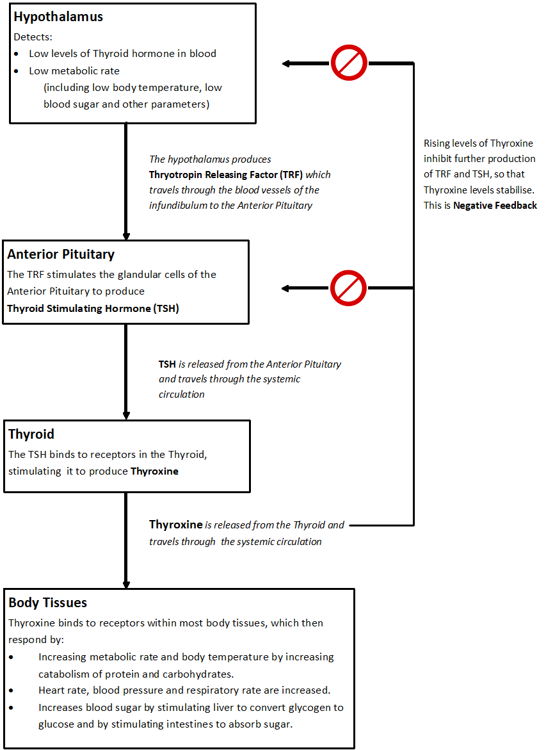
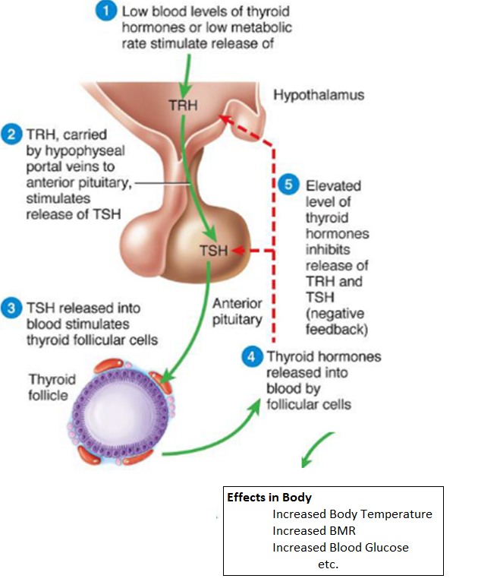
Regulation of Thyroxine production
Learning Aim: Explain in detail how thyroxine is regulated and its effects on the body.

Slide 7

Thyroid hormone imbalance and disease
Problems with Thyroid hormone production affect homeostasis, causing disease.
Hyperthyroidism – Too much Thyroid hormone produced
Hypothyroidism – Too little Thyroid hormone produced

Slide 8
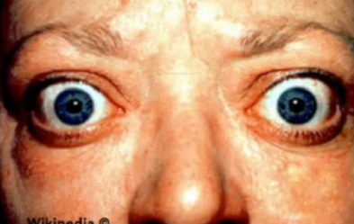
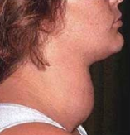
Hyperthyroidism – too much thyroid hormone
Common causes: | Symptoms | Diagnosis | Treatment
Graves’ Disease – immune system produces antibodies which stimulate thyroid to produce hormones | Weight loss (or gain) Increased appetite Protruding eyeballs Fast heart rate Sleep disturbances Anxiety/nervousness Fatigue Muscle weakness Goitre | Blood test for TSH – lower than normal. Why? Testing for antibodies Radioactive iodine uptake by thyroid Ultrasound/CT scan/MRI | Radioactive iodine therapy given as medication taken up by thyroid destroys thyroid cells Less thyroid hormone produced Anti-thyroid medication Prevents thyroid from using iodine to make hormones Surgery
Thyroid nodules/adenoma – iodine deficiency causes overgrowth of thyroid tissue to try to produce more hormone, which also impacts on TSH production.
Thyroiditis – inflammation of the thyroid causes overproduction of hormone
Learning Aim: Discuss disorders related to over and undersecretion of thyroxine

Slide 9
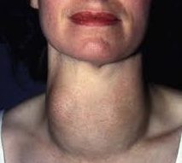
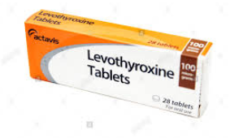
Hypothyroidism – too little thyroid hormone
Common Causes | Symptoms | Diagnosis | Treatment
Hashimoto’s Disease – autoimmune disease attacks thyroid tissue, destroying it so it cannot produce hormone. | Fatigue Weakness Weight gain Depression Cold intolerance Dry, rough skin Brittle dry hair Goitre | Blood test – low levels of T4, high levels of TSH (why?) unless pituitary problem. | Thyroid hormone replacement medication: Levothyroxine Synthetic thyroid hormone tablets Replace missing hormone
Thyroid destroyed by medication or surgery to correct hyperthyroidism
Not enough dietary iodine – mostly a problem in developing nations – body can’t produce hormone without iodine
Learning Aim: Discuss disorders related to over and undersecretion of thyroxine

Slide 10

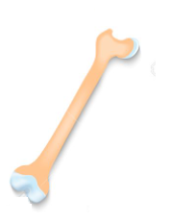
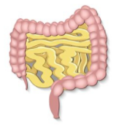
The Thyroid and Thyrocalcitonin
The thyroid gland also makes Thyrocalcitonin which is produced if Ca²⁺ levels in the blood are too high. *think back to Yr 11. Why would high blood Ca²⁺ be a problem?
Thyrocalcitonin reduces Ca²⁺ in the blood by:
Preventing Ca²⁺ from being reabsorbed by the kidney (so more is excreted in urine).
Promoting Ca²⁺ deposition in the bones (laying calcium down into the bone matrix).
Decreasing Ca²⁺ absorption by the intestines.
*note: Thyrocalcitonin works in balance with Parathyroid Hormone (PTH) produced by the Parathyroid. We will discuss their regulation together in the next lesson.
Learning Aim: Explain the effects thyrocalcitonin has on the body

